Slide 1
Dynamic Code Using Custom Settings
John Thompson
Manager - Application Development, KVH Industries
jthompson@kvh.com
@latentfuss

Slide 2





John Thompson KVH Industries
Manager - Application Development
Salesforce Platform Developer 1

Slide 3
Forward-Looking Statements
Statement under the Private Securities Litigation Reform Act of 1995:
This presentation may contain forward-looking statements that involve risks, uncertainties, and assumptions. If any such uncertainties materialize or if any of the assumptions proves incorrect, the results of salesforce.com, inc. could differ materially from the results expressed or implied by the forward-looking statements we make. All statements other than statements of historical fact could be deemed forward-looking, including any projections of product or service availability, subscriber growth, earnings, revenues, or other financial items and any statements regarding strategies or plans of management for future operations, statements of belief, any statements concerning new, planned, or upgraded services or technology developments and customer contracts or use of our services.
The risks and uncertainties referred to above include – but are not limited to – risks associated with developing and delivering new functionality for our service, new products and services, our new business model, our past operating losses, possible fluctuations in our operating results and rate of growth, interruptions or delays in our Web hosting, breach of our security measures, the outcome of any litigation, risks associated with completed and any possible mergers and acquisitions, the immature market in which we operate, our relatively limited operating history, our ability to expand, retain, and motivate our employees and manage our growth, new releases of our service and successful customer deployment, our limited history reselling non-salesforce.com products, and utilization and selling to larger enterprise customers. Further information on potential factors that could affect the financial results of salesforce.com, inc. is included in our annual report on Form 10-K for the most recent fiscal year and in our quarterly report on Form 10-Q for the most recent fiscal quarter. These documents and others containing important disclosures are available on the SEC Filings section of the Investor Information section of our Web site.
Any unreleased services or features referenced in this or other presentations, press releases or public statements are not currently available and may not be delivered on time or at all. Customers who purchase our services should make the purchase decisions based upon features that are currently available. Salesforce.com, inc. assumes no obligation and does not intend to update these forward-looking statements.
Notes:
Key Takeaway: We are a publicly traded company. Please make your buying decisions only on the products commercially available from Salesforce.
Talk Track:
Before I begin, just a quick note that when considering future developments, whether by us or with any other solution provider, you should always base your purchasing decisions on what is currently available.

Slide 4
What we will see today
Demo and Review two dynamic apps
Both use Custom Settings
Hierarchy Type in one
List Type in the other
Suggest additional Custom Settings use cases
Compare Custom Metadata Types to Custom Settings
Notes:
So here’s what I’m going to cover today.
Couple of demos, some food for thought, and a quick comparison

Slide 5

Where do you do most of your development?
Sandbox
OR
Developer Org
Notes:
By show of hands, who does most of their work in a Sandbox?
….and who does most of their work in a Dev Org?
We’re going to talk mostly about sandboxes first.

Slide 6


Code Behavior
Production vs. Sandbox
Should be the same …. or not?
Dev Sandbox
Full (QA) Sandbox
Production
^{Deploy}
^{Deploy}
A + B = C
A + B = C
A + B = C
Notes:
Normally, you want and expect that your code does the same thing in a dev sandbox, a full sandbox, and production. If it doesn’t… well that’s usually when you get “The Call….”

Slide 7
Code Behavior
Production vs. Sandbox
Should be the same… typically
Unless you have a data integration
External Billing System
External Service Provisioning System
External ERP System
Another Salesforce Production Org
etc…
Notes:
Data integration to external systems can take many forms. Billing Systems, ERPs, even sending out an E-mail could be considered a form of data integration

Slide 8

Code Behavior
…mis-behavior in this case!
Dev Sandbox
Full (QA) Sandbox
Production
^{Deploy}
^{Deploy}
You do not want this!!
External System
(Production)
Notes:
You do not want this! You really want to prevent any sandbox data from integrating with external Production Systems.

Slide 9
Code Behavior
This is how data integrations need to work!
Dev Sandbox
Full (QA) Sandbox
Production
^{Deploy}
^{Deploy}
External System
(Mock)
External System
(Dev or Mock)
External System
(Production)
Notes:
This is how you want your Sandboxes to integrate. If you are fortunate, your external systems will have Dev or Sandbox instance for you to develop against. If you are less fortunate, you will have to mock those external systems.
SO! How do we make that happen… you could manually adjust remote site settings, tweak lines of code, or other un-scalable approached.
But as it turns out, there’s a pretty straightforward design pattern.

Slide 10




Dynamic Code Behavior Design Pattern
Production vs. Sandbox
Determine Current Org Id
(From UserInfo Class)
Match?
Lookup Production Org Id
Compare the two
Do Production Behaviour
(From Custom Setting)
Non-Match?
Do SandboxBehaviour
Notes:
Lookup Production Org Id (from Custom Setting)
Determine Current Org Id (from UserInfo Class)
Compare the two
Match means we are in Production, non-Match mean we are NOT in production

Slide 11


Custom Settings
A super quick overview…
What are they?
Unique properties!
Why use them?
Considerations…
Special Kind of Custom Object
Data sets, not records
Two Types, List and Hierarchy
Data sets migrated to Sandbox on refresh
Cached data
SOQL not required
Not visible to unit tests
No owners of FLS
Notes:
Special kind of Custom Object… like the love child of Custom Objects and Metadata
They have datasets, not records
Two main types… Hierarchy can be used in formulas, process builder and workflow
They live in the application cache… don’t need SOQL to get at the datasets
Not visible to unit tests, Must be setup in test Classes like test Opportunites, test Accounts, etc…
No Owners or Field Level Security
Migrated to Sandboxes on refresh

Slide 12
Lookup Production Org Id
h_Production_Org_Ids__c, our example Custom Setting
Hierarchy Custom Setting
Makes it available in Formulas, Workflow, Process Builder
One Data Set
At the Organization Default level
Kind of important – applies to all Users!
Two Custom Fields
Org_Id_15_char__c (text, 15)
Org_Id_18_char__c (text, 18)
Notes:
First step… Lookup Production Org Id.
We are going to store that value in a Hierarchy Type Custom Setting since we are going to use Process Builder and Workflow as well as Apex in the demo
We have two Custom Fields. One holds a 15 character Org Id (as text). One holds are 18 character Org Id.
We populate our Custom Setting with only one data set. That’s kind of like populating a custom object with only one record.
Kind of important… .we populate that one data set at the Organization Default Level.

Slide 13
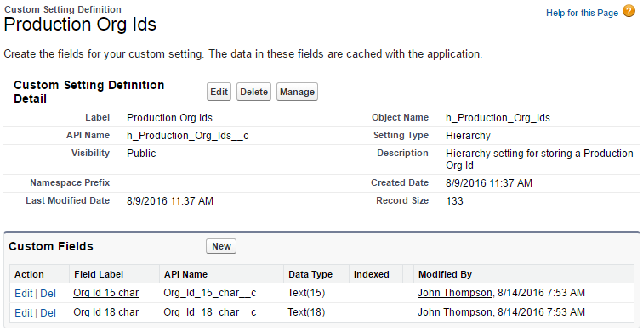
Lookup Production Org Id
Setup view
Notes:
Setup screen with the two custom fields

Slide 14
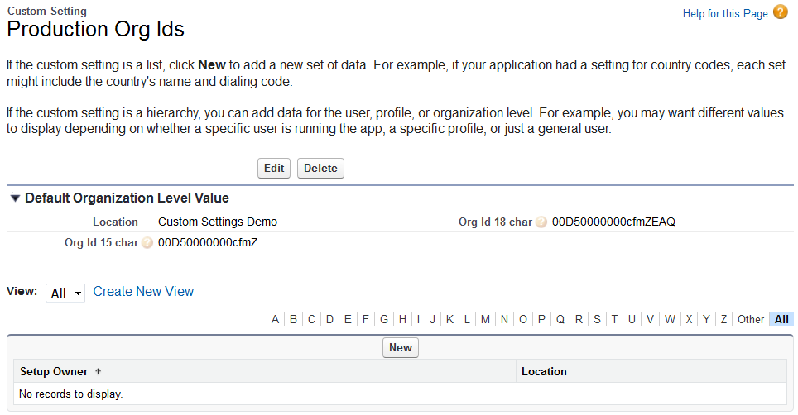
Lookup Production Org Id
Manage Data Sets view
Notes:
Dataset management screen
Note that the 18 char Org ID looks like a case safe version of the 15 char Org Id, which makes perfect sense.

Slide 15
Lookup Production Org Id
How to read the Custom Setting Data Set
 | Method/Global Variable | Return
In Apex | Use Hierarchy Custom Settings Methods h_Production_Org_Ids__c.getOrgDefaults(); | The whole Organization Default Level dataset
In Formulas | $Setup.<Custom Setting Name>.<Custom Field> ($Setup Global Variable -> $h_Production_Org_Ids__c ->Org_Id_15_char__c) | That exact field value (the 15 character Org Id)
In Lightning Process Builder | $Setup.h_Production_Org_Ids__c.Org_Id_15_char__c | That exact field value (the 15 character Org Id)
Notes:
To lookup Custom Setting values in Apex we use Custom Settings Methods… There are different methods for List and Hierarchy Custom Settings…but they are all instance methods
In Formulas and Process Builder, the Custom Settings are surfaced through the $Setup Global Variable…. Very easy to figure out when you are putting it together.

Slide 16
Determine Current Org Id
 | Method/Global Variable | Return
In Apex | UserInfo.getOrganizationId(); | 18 character Org Id
In Formulas | $Organization.Id (System Variable -> $Organization ->Organization Id) | 15 character Org Id
In Lightning Process Builder | $Organization.Id | 15 character Org Id
Notes:
Step 2, determine the current Org Id.
Getting the current Org Id really depends on what you are using to build your solution.
Apex has the UserInfo Class with a getOrganizationId(); method.
For Workflows, formulas, and Processes, you have the $Organization global variable.
You just have to pay attention to 15 vs. 18 character results and this is why we have both a 15 character and 18 character Org Id in our Custom Setting

Slide 17
Dynamic Code Demo
Notes:
In Sandbox Org:
- load Lightning tab. UI button implements that design pattern, and updates a component attribute
- create Case. We have added a formula field to the case, there’s a process that makes a chatter post, and we have a workflow rule that updates the Case.Subject
In Production Org
- Same procedure

Slide 18
Code Review
Markup
<aura:component controller="instanceCheck" implements="force:appHostable" >
<aura:attribute name="myText" type="String" default="Click 'Check' to
identify Instance" />
<c:instanceCheckHeader />
<div class="slds-p-around--medium">
<p>{!v.myText}</p>
</div>
<div class="slds-p-around--medium">
<p><ui:button label="Check" press="{!c.check}" /></p>
</div>
</aura:component>
Notes:
Component has a text attribute… and a button.
Button invokes a client side controller action.

Slide 19
Code Review
Client Side Controller
({
check: function(component, event, helper) {
//get server value
var action = component.get('c.getIsProduction');
//handle response from server
action.setCallback(this, function(response) {
var respData = response.getReturnValue();
component.set('v.myText', respData ? 'This is a Production Org' :
'This is a Sandbox Org');
});
//Send request to server
$A.enqueueAction(action);
}
})
Notes:
The action invokes the server side apex Class that returns a Boolean.
We evaluate the Boolean using a ternary operator, then update the text attribute

Slide 20
Code Review
Server Side Controller
public with sharing class instanceCheck {
@AuraEnabled
public static boolean getIsProduction(){
boolean isProduction;
h_Production_Org_Ids__c mySetting = new h_Production_Org_Ids__c();
mySetting = h_Production_Org_Ids__c.getOrgDefaults();
string currentOrgId = UserInfo.getOrganizationId();
if(currentOrgId == mySetting.Org_Id_18_char__c){
isProduction = true;
} else {
isProduction = false;
}
system.debug('isProductionOrg = ' + isProduction);
return isProduction;
}
}
Notes:
This is where we implement that basic design pattern in the server-side Apex
Create a variable to represent our Custom Setting, populate with the Org Defaults
Create another variable (string) and populate that with the Org Id from the UserInfo Class
Compare the two, set the Boolean, and return it.

Slide 21
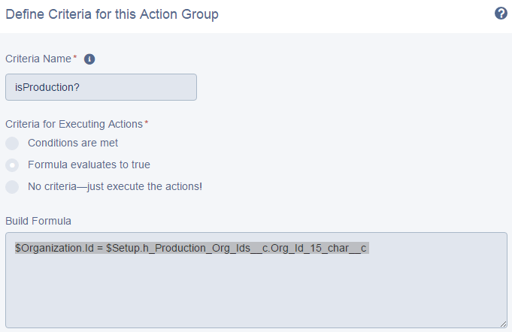
Code Review
Process builder formula
Notes:
Just like in the apex controller, the fundamental part is comparing the current Org Id to the Org Id stored in the custom setting. Without getting too deep into process builder, here’s that critical decision point expressed as a formula. Current Org Id on the left, custom setting value on the right.

Slide 22
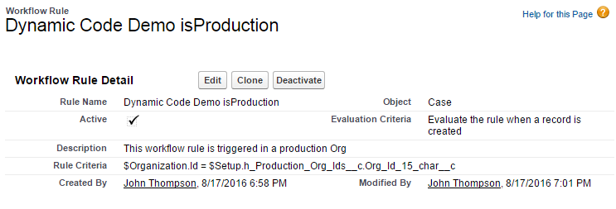
Code Review
Workflow Rule
Notes:
Essentially the same deal and syntax here in the workflow rule.

Slide 23
Practical Org Id application
The Demo is just a Demo…
Boils down to conditional execution
Control the endpoint
https://api.service.com vs. https://apitest.service.com
Control the callout
Mock the process or really make the call
Control the process
A + B = C or A + B = D
Notes:
As is, our little Org.Id demo here is far from practical, but does demonstrate conditional execution based on sandbox vs. production.
We can leverage that conditional execution to do whatever we need to. To dynamically control the endpoint for a callout, or not even make a callout at all. Whatever we need to do.

Slide 24
Thresholds
A Custom Settings application

Slide 25
Thresholds
What’s it all about
An automatic monitoring system
Does something when a threshold is reached
Creates a case in our example
Dynamically adjusts the threshold after being triggered
Appropriate for a “slow burn” process
Not for something you would put on a dashboard
Notes:
The Thresholds app is a means to monitor a slow moving process. This is not the kind of thing that goes on a dashboard, because It looks the same day after day.
Use this for something that takes a year or so before it needs attention.

Slide 26
Thresholds
Use Case for a “Slow Burn” process
Notes:
The Thresholds app is a means to monitor a slow moving process. This is not the kind of thing that goes on a dashboard, because It looks the same day after day.
Use this for something that takes a year or so before it needs attention.

Slide 27
Thresholds
Use case
There’s a fixed number of Licenses in the Org
Issued one at a time
Can’t be immediately replenished
Requirements:
Monitor number of available Licenses
Open a case when we get to a certain “Threshold” level
Implied Requirement:
Don’t open a bunch of duplicate Cases
Notes:
So there’s this thing called a License, issued one at a time. Licenses are either Issued or available.
They need to be replenished at some point, and that might take some time. We *DO NOT* want to run out of Licenses.
We want to monitor the number of available Licenses, and open a case when we get to a certain level.
We also don’t want to open a bunch of duplicate cases when we issue license after we hit that treshold

Slide 28
Thresholds
The bits and pieces
Something that needs monitoring/measuring
We’ll use a custom sObject in our example/demo, “Licenses”
Licenses are either issued or available
A list type Custom Setting
One of more numeric fields
A Means to invoke an Apex Class
Scheduled Apex is recommended, Wired up to a button for the demo
An Apex Class/Method
Method for measurement
Method for taking action!
Notes:
What are we going to monitor. In the demo it’s a custom object called a License
We need a Custom Setting with numeric fields
We need a way to invoke an apex class to make a measurement (e.g. scheduled apex) and take action if required

Slide 29
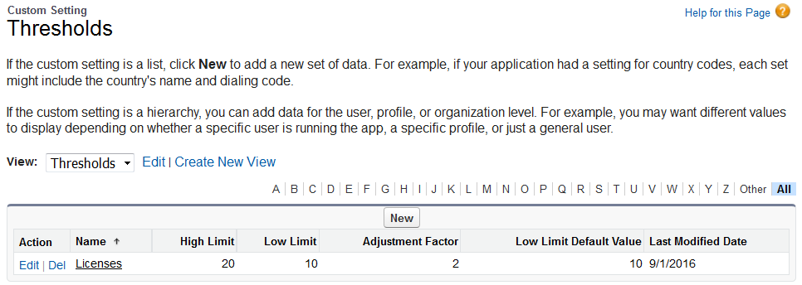
Code Review
Thresholds__c Custom Setting (list type)
Notes:
Just a few integers, a High Limit, a Low Limit, and Adjustment Factor, and a Low Limit Default value…

Slide 30
Thresholds
Demo and Code Review
Notes:
Ok, for this demo we are going to work with our Licenses__c sObject. This is a VERY contrived demo… We have some licenses with a few to spare… that is above our threshold. We will issue a few, and observe the results. Then we will issue a few more and observe MORE results!
Finally we will replenish our Available Licenses, and see what happens then.
Please don’t let me forget to invoke that scheduled apex!

Slide 31
Code Review
checkThresholds Method
public void checkThresholds(){
Integer availableLicenses = [SELECT count() FROM License__c
WHERE isIssued__c = false];
thresholds__c thresholds = thresholds__c.getInstance('Licenses');
if(availableLicenses <= thresholds.Low_Limit__c){ //Adjust limit DOWN
double newLowLimit = math.floor(thresholds.Low_Limit__c /
thresholds.Adjustment_Factor__c);
thresholds.Low_Limit__c = (integer)newLowLimit;
update thresholds; //Adjust limit DOWN
case createdCase = createLowLimitCase(
availableLicenses, thresholds); //Create a Case
} else if (availableLicenses >= thresholds.High_Limit__c &&
thresholds.Low_Limit__c != thresholds.Low_Limit_Default_Value__c){
thresholds.Low_Limit__c = thresholds.Low_Limit_Default_Value__c;
update thresholds; //Adjust the limit UP
}
return thresholds;
}
Notes:
We clicked a button to invoke this method, but a practical application will probably use scheduled Apex
Familiar pattern. Create a variable to represent out Custom Setting, populate that variable using one of those instance methods
Compare to the results of an aggregate query
Take action or not based on the results of that aggregate query
Adjust the threshold DOWN with a DML statement.
Adjusting UP is a little more complex, we want to make sure that the threshold isn’t already at the Default Low Limit.

Slide 32
Code Review
createLowLimitCase Method
public Case createLowLimitCase(integer availableLicenses,
thresholds__c newSettings){
Case LowLimitCase = new Case();
LowLimitCase.Description = 'The number of available Licenses is ' +
availableLicenses + '\r\n' + 'The warning threshold has been
adjusted to : ' + newSettings.Low_Limit__c;
LowLimitCase.Origin = 'Web';
LowLimitCase.Priority='Critical';
LowLimitCase.Status='New';
insert LowLimitCase;
return LowLimitCase;
}
Notes:
Just a quick look at the Apex that creates a case behind the thresholds app..

Slide 33
Other Custom Settings use cases

Slide 34
Additional Custom Settings use Cases?
Ever been tempted to hard code a record Id?
Don’t do it! Use a Custom Setting instead!
Community applications
Correlate Account Record Type with Community User Profile Id
Create defaults for new Community users (Profile, Roles, Groups, Permission Sets….)
Values that might need adjustment over time
Trial Period
Notes:
There’s some other use cases that Custom Settings handle pretty well
Avoiding hard coded record Ids
Default values for complex business processes
A means to make adjustments periodically

Slide 35
Additional Custom Settings use Cases?
Ever been tempted to hard code a record Id?
Don’t do it! Use a Custom Setting instead!
Community applications
Correlate Account Record Type with Community User Profile Id
Create defaults for new Community users (Profile, Roles, Groups, Permission Sets….)
Values that might need adjustment over time
Trial Period
Notes:
Trial period, true story

Slide 36
Custom Settings
Other Use Cases – Trial Period
Initial requirement, 31 day trial…
if (Service.isTrial) { Service.End_Date__c = Date.today() + 31; }
<apex:facet name="header">Is 31 Day Trial</apex:facet>
Build Change Set, Upload, Validate, Deploy….
First revision, 37 day trial…
if (Service.isTrial) { Service.End_Date__c = Date.today() + 37; }
<apex:facet name="header">Is 37 Day Trial</apex:facet>
Build Change Set, Upload, Validate, Deploy….
Second revision, 60 day trial…
if (Service.isTrial) { Service.End_Date__c = Date.today() + 60; }
<apex:facet name="header">Is 60 Day Trial</apex:facet>
Build Change Set, Upload, Validate, Deploy….
Notes:
True story….

Slide 37
Custom Settings
Other Use Cases – Trial Period
If I was smart…
I’d have made a Custom Setting
if (Service.isTrial) { Service.End_Date__c = Date.today() + cs.days__c; }
<apex:facet name="header">Is {!cs.days__c} Day Trial</apex:facet>
Changes to trial period are implemented by changing the custom setting value
If I was REALLY smart…
Still use that Custom Setting
Make a Lightning Component or Visual Force page/controller
Users can set the trail period to whatever/whenever

Slide 38
Custom Metadata Types

Slide 39
About Custom Metadata Types
Similar purpose and architecture to List Custom Settings
Access through SOQL
Does not count against governor limits!
Datasets deployable through Change Sets
Visible to Unit Tests (Is Metadata, yes!?)
Almost everything we saw today can be done with CMTs
Mostly Awesome, but….
Notes:
I like to think of CMTs as the next generation of Custom Settings. What they are is a boatload of awesome….

Slide 40
A word about Custom Metadata Types
Mostly Awesome, but….
NOT available for Formulas, Process Builder, and Workflow Rules
SO!
Vote up this idea
Use Custom Metadata Types in Process Builder, Formulas/Validation Rules
https://success.salesforce.com/ideaView?id=0873A000000E32UQAS
Link in chatter feed!
Notes:
What they are not is compatible with Formulas, Process Builder, and Workflow.
I would like to ask everyone to review and vote up this Idea. Link in the Session Chatter feed.

Slide 41
Key Takeaways
Custom Settings Data Sets are migrated to Sandboxes
But not visible to Apex Tests
Makes Sandbox vs. Production distinction possible!
“If you can’t make it perfect, make it adjustable.”
Custom Settings make great little adjustment controls in Salesforce
Custom Metadata Types are the next generation of List Type Custom Settings
Don’t forget to vote that Idea up!
Notes:
Get to know the unique properties of Custom Settings
I don’t know where I heard that quote… maybe in science fiction novel. Custom Settings make great little control mechanisms.

Slide 42
Suggested Dreamforce ‘16 Sessions
Custom Metadata - Your Key to Dynamic Code
https://success.salesforce.com/Sessions?eventId=a1Q3000000qQOd9#/session/a2q3A000000LBSQQA4
Tuesday, Oct 4, 9:15 AM – 9:45 AM Moscone West Developer Theater
Build Sophisticated App Configurations with Custom Metadata
https://success.salesforce.com/Sessions?eventId=a1Q3000000qQOd9#/session/a2q3A000000LBeaQAG
Friday, Oct 4 8:00 AM – 8:40 AM Moscone West 2004

Slide 43
Resources
Custom Settings documentation
https://developer.salesforce.com/docs/atlas.en-us.apexcode.meta/apexcode/apex_customsettings.htm
Apex Basics & Database Trailhead Module
https://trailhead.salesforce.com/en/module/apex_database
Take a look at Custom Metadata Types
https://trailhead.salesforce.com/en/module/custom_metadata_types
Explore Change Management
https://trailhead.salesforce.com/module/app_deployment
TL:DR Where’s the code?
https://github.com/latentfuss/CustomSettingsApps

Slide 44
Questions?
Sorry…. Out of time
Hit me up in:
Twitter
GitHub
Success Community
E-mail
Meet me over there….

